Slide 1
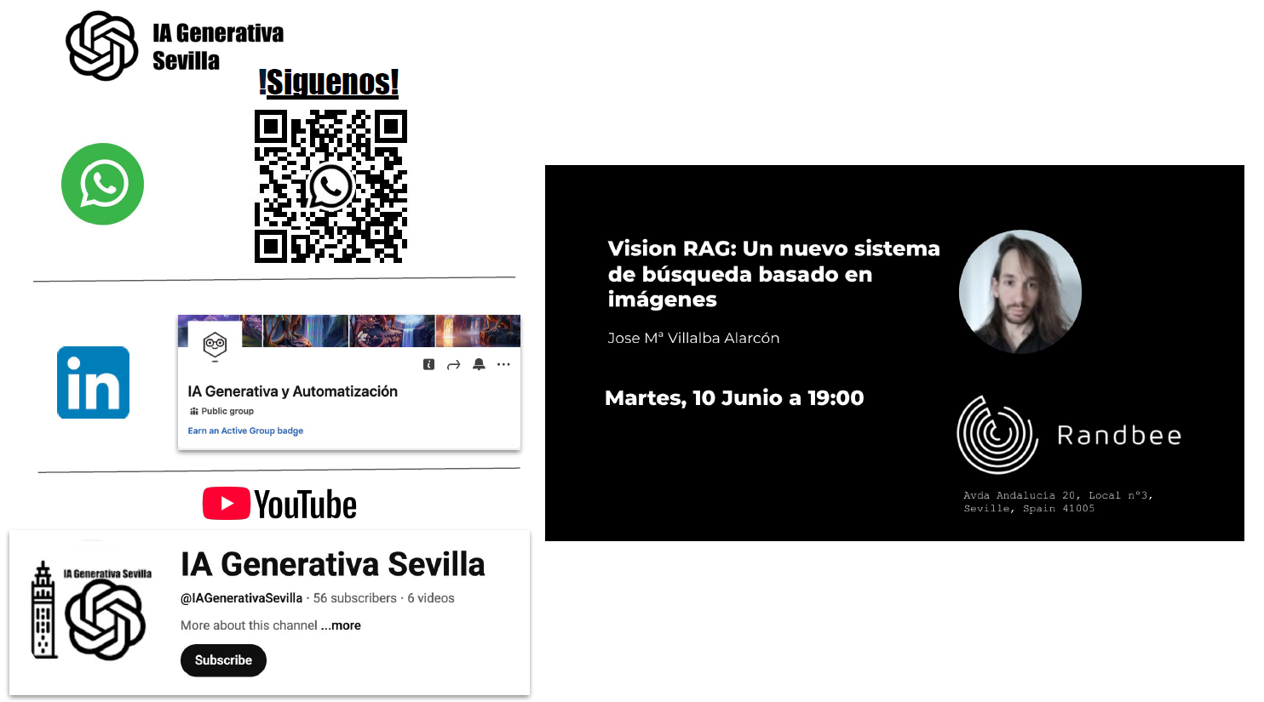

Slide 2


Data Science and Visualization
Making available data-driven insights for decision making
Notes:
Welcome to our presentation on data science and visualization services. We specialize in transforming complex data into actionable insights that drive strategic decision-making for organizations across various sectors. Our expert team combines advanced analytical methods with powerful visualization techniques to help you discover patterns, trends, and opportunities hidden in your data.
Throughout this presentation, we'll explore our comprehensive service offerings, showcase successful client projects, and demonstrate how our data-driven solutions can address your specific business challenges.

Slide 3





Our Services
Statistical Analysis
Big Data Processing
Decision Support Tools
Training & Hackathons
Spatial data analysis and mapping tools that reveal geographical insights.
Expert programming in R and Python for statistical analysis and management.
Custom interactive dashboards that facilitate data-driven decision making.
Specialized hackathons to promote innovation and entrepreneurship.

Slide 4
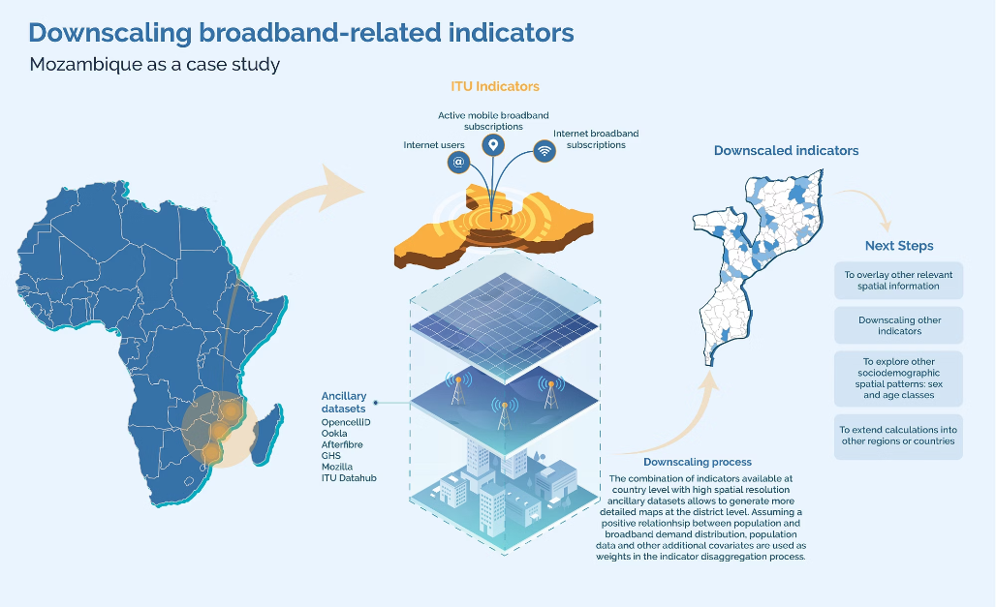
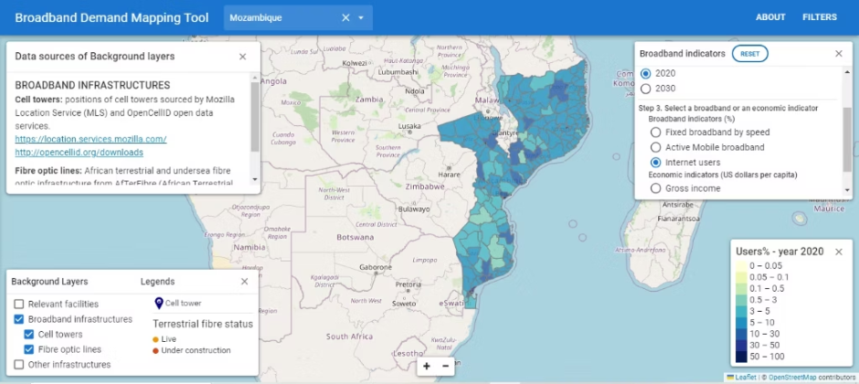
Investment Decision Support Tool
Challenge
Our Approach
Results Delivered
Creating accurate spatial indicators of broadband demand from global open data sources for Africa and Asia to guide investment decisions.
Implemented sophisticated dasymetric algorithms to downscale country-level data to subnational levels for 2020 and 2030.
Produced detailed spatial indicators covering fixed broadband by speed, mobile usage, demographics, and affordability metrics.
Incorporated rural/urban distinctions and gender-specific factors.
Provided precise geographic insights for high-potential investment opportunities.
Traditional approaches lacked granularity and regional variation insights.

Slide 5
Visión RAG:
Un nuevo enfoque basado en imágenes

Slide 6
Definiciones Previas RAG Tradicional:
RAG: Siglas de “Retrieval Augmented Generation”, es una técnica para incluir contenido de documentos propios al contexto de un LLM.
Embedding: Representación numérica de un texto, imagen o audio.
OCR: Siglas de “Optical Character Recognition”, es un método que usa diferentes framework y/o técnicas para la extracción de textos, tablas e imágenes de documentos.
Chunks: “Pedazos” de información de los documentos (textos, tablas, imágenes…) extraídos mediante OCR

Slide 7
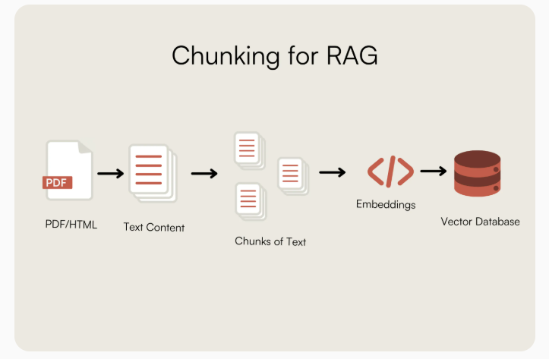
source: https://www.multimodal.dev/post/how-to-chunk-documents-for-rag

Slide 8
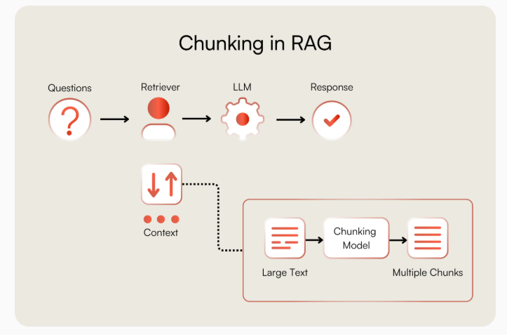
source: https://www.multimodal.dev/post/how-to-chunk-documents-for-rag

Slide 9
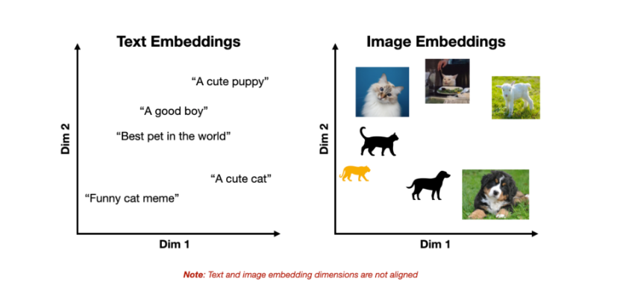
Vision RAG: Embeddings Monomodales
source: https://towardsdatascience.com/multimodal-embeddings-an-introduction-5dc36975966f/

Slide 10
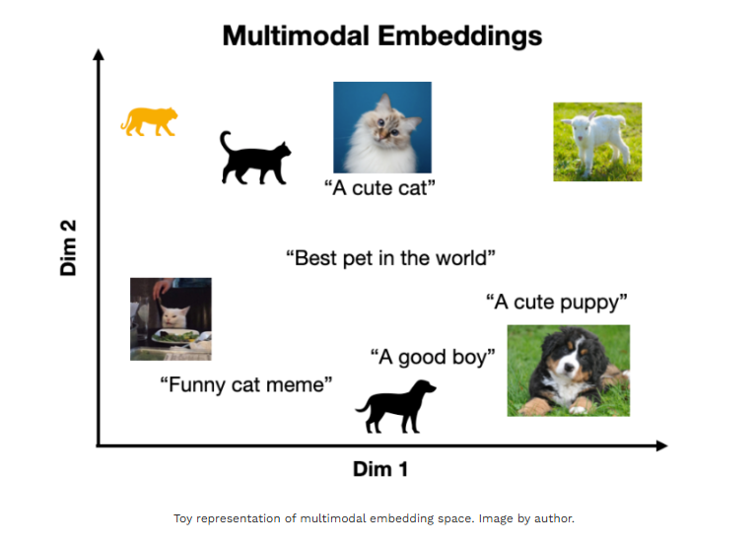
Vision RAG: Embeddings Multimodales
source: https://towardsdatascience.com/multimodal-embeddings-an-introduction-5dc36975966f/

Slide 11
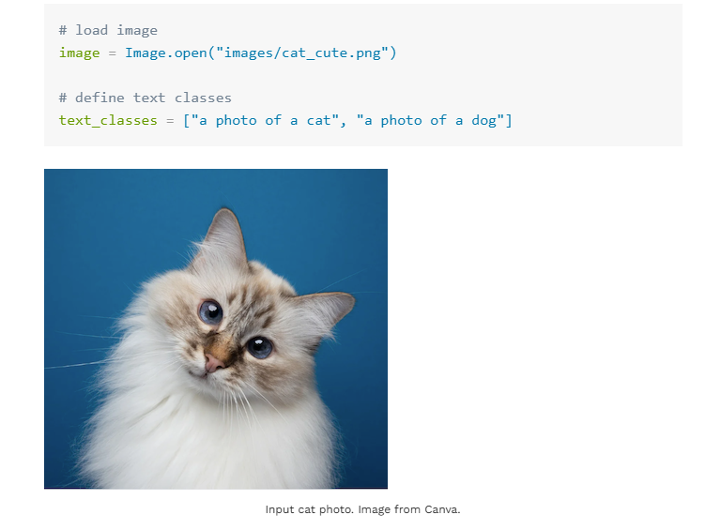
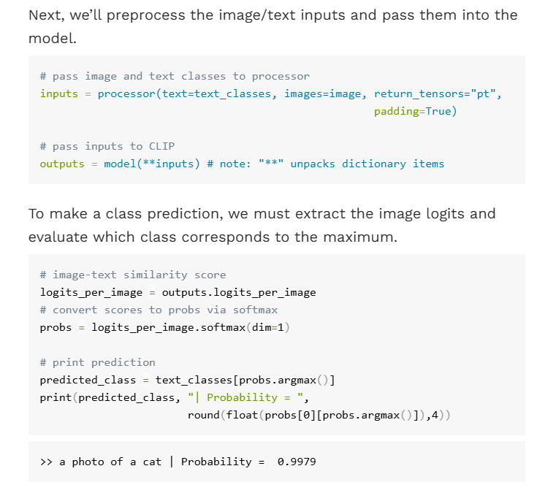
Vision RAG: Embeddings Multimodales
La gran ventaja de los embeddings multimodales es que podemos crear una correspondencia entre un elemento inicial (texto, imagen, audio) a un elemento final (texto, imagen, audio) sin que ambos deban ser del mismo tipo.
source: https://towardsdatascience.com/multimodal-embeddings-an-introduction-5dc36975966f/

Slide 12
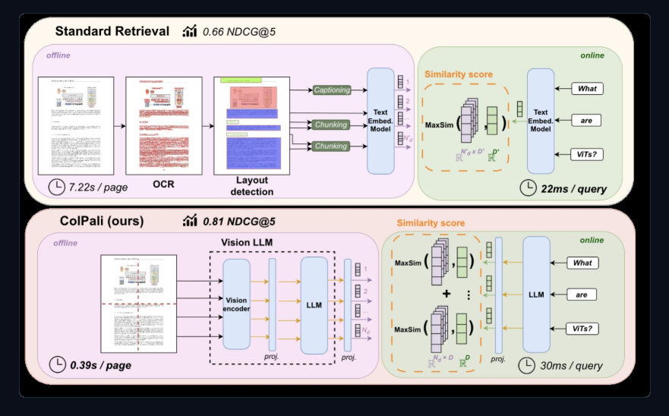
Vision RAG: ColPali/ColQwen
source: https://huggingface.co/blog/manu/colpali

Slide 13
Vision RAG: Aproximación
Una imágen (.png, .jpg…) a través de procesamiento por redes neuronales (PyTorch) la transformamos directamente a información numérica en embedding multimodal.
El algoritmo de ColQwen genera un tensor de tipo: torch.Tensor([1, 731, 128]), es decir, genera 731 particiones en cada imágen y a cada cuál le asigna un embedding multimodal de 128 componentes.
Este proceso, abstrae y simplifica todo el proceso del RAG Tradicional del OCR, extracción de la información por chunks, organización de la información, decisión del indexado…
Menos propensión a errores en la pipeline a cambio de saber controlar y manejar los procesos de PyTorch y modelos de visión.

Slide 14
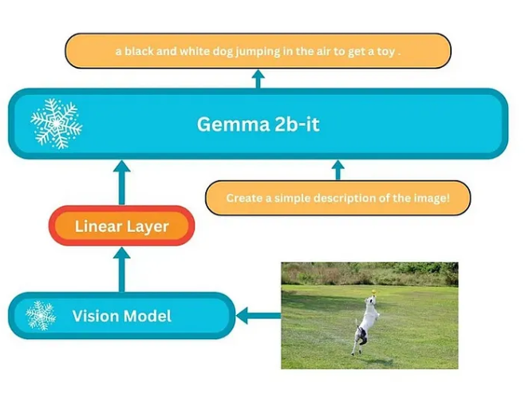
Vision LLM

Slide 15
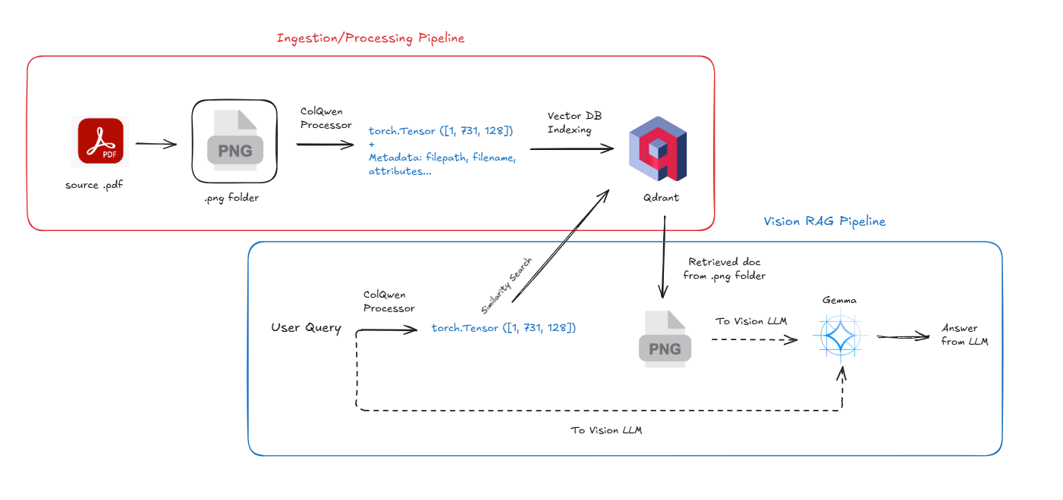
Project Pipeline

